Slide 1
Healthy Churches Develop godly leaders
1 Timothy 3:1-16
Preached by Dr. Jim Harmeling at Crossroads International Church Singapore • cicfamily.com Uploaded by Dr. Rick Griffith • Singapore Bible College Thousands of files in 49 languages for free at BibleStudyDownloads.org

Slide 3
Lead in front,
don’t push from behind
Don’t dominate
Be sensitive to needs

Slide 4
Healthy Church Life
Studies in 1 Timothy

Slide 5
Healthy Churches Develop godly leaders
1 Timothy 3:1-7

Slide 6
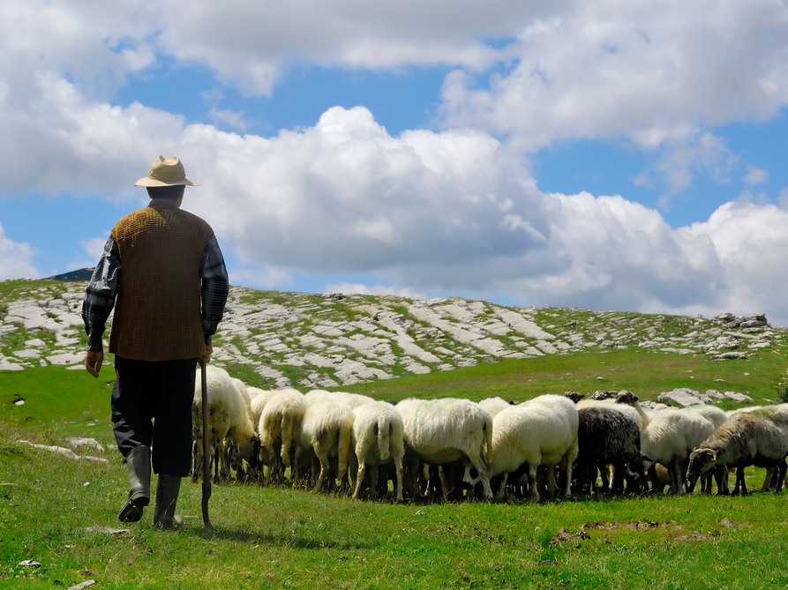
They Raise up Godly Elders (vs. 1-7)

Slide 7
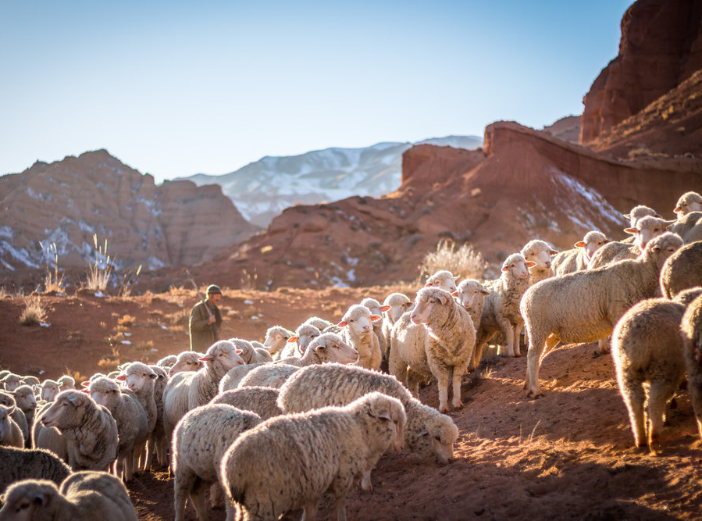
Review
1 Timothy 2:11-14
Men are to lead the church
Women can still speak
Women can still teach
Women can still lead

Slide 8
The saying is trustworthy: If anyone aspires to the office of overseer, he desires a noble task.
Elder = Who? Older man
Overseer = What? Oversee
Pastor = How? Like a shepherd

Slide 9
Acts 20:17, 28
¹⁷ Now from Miletus he sent to Ephesus and called the elders of the church to come to him.
²⁸ Pay careful attention to yourselves and to all the flock, in which the Holy Spirit has made you overseers, to care for the church of God, which he obtained with his own blood.

Slide 10
1 Peter 5:1-2
¹ So I exhort the elders among you, as a fellow elder and a witness of the sufferings of Christ, as well as a partaker in the glory that is going to be revealed: ² shepherd the flock of God that is among you, exercising oversight, not under compulsion, but willingly, as God would have you; not for shameful gain, but eagerly;

Slide 11
14 Character Traits For Church Overseer
They are not flirtatious (“the husband of one wife”)
2. They are personally disciplined (“sober-minded”)
3. They are mentally and emotionally balanced (“self-controlled”)
4. They are not out of control (“respectable”)
5. They practice hospitality (“hospitable”)
6. They are able to teach the Bible (“able to teach”)
7. They are not addicted to chemicals (“not a drunkard”)
8. They control their temper (“not violent”)
9. They are considerate of others (“gentle”)

Slide 12
“It expresses that considerateness that looks humanely and reasonably at the facts of a case.”

Slide 13
14 Character Traits For Church Overseer
They are not flirtatious (“the husband of one wife”)
2. They are personally disciplined (“sober-minded”)
3. They are mentally and emotionally balanced (“self-controlled”)
4. They are not out of control (“respectable”)
5. They practice hospitality (“hospitable”)
6. They are able to teach the Bible (“able to teach”)
7. They are not addicted to chemicals (“not a drunkard”)
8. They control their temper (“not violent”)
9. They are considerate of others (“gentle”)
10. They are peace makers (“not quarrelsome”)

Slide 14
14 Character Traits For Church Overseer
11. They are not materialistic (“not a lover of money”)
12. They manage their homes well (“He must manage his own household well, with all dignity keeping his children submissive, for if someone does not know how to manage his own household, how will he care for God’s church?”)
13. They are not a young Christian (“He must not be a recent convert, or he may become puffed up with conceit and fall into the condemnation of the devil”)
14. They have a favorable testimony among unbelievers (“…he must be well thought of by outsiders, so that he may not fall into disgrace, into a snare of the devil”)

Slide 15
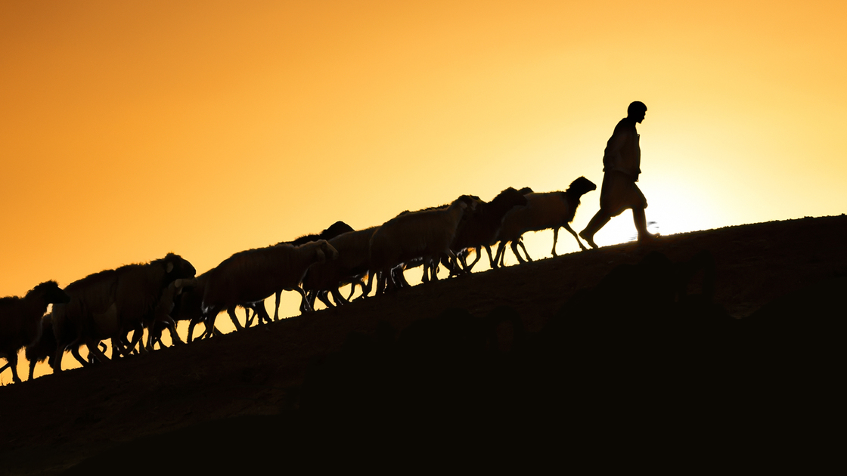

Slide 17
NT Preaching • BibleStudyDownloads.org
Get this presentation for free!

